Slide 1
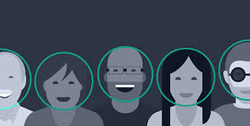
Face Detection

Slide 2
Biometrics
A biometric is a unique, measurable characteristic of human being that can be used to automatically recognize an individual or verify an individual's identity

Slide 3
Types of Biometrics
Physiological
Finger-scan
Facial Recognition
Iris-scan
Retina-scan
Hand-scan
Behavioral
Voice-scan
Signature-scan
keystroke-scan

Slide 4
Facial Recognition
It requires no physical interaction on behalf of the user.
It is accurate and allows for high enrolment and verification rates.
It can use your existing hardware infrastructure, existing cameras and image capture Device will work with no problems

Slide 5
Facial Recognition
In Facial recognition, there are two types of comparison:-
Verification
Identification

Slide 6
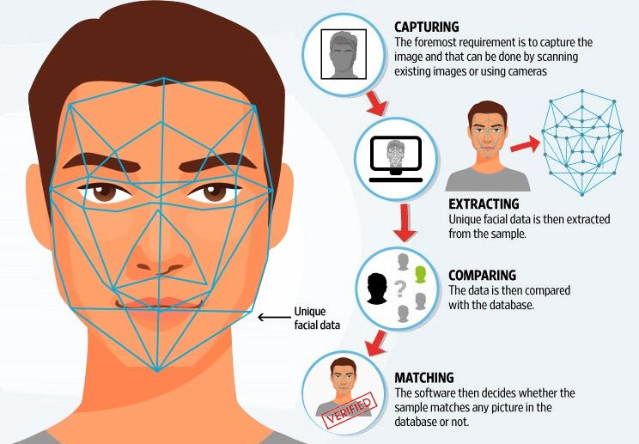
Facial Recognition
Facial recognition technology operate using following stages:-
Capture
Extraction
Comparison
Match/non-match

Slide 7
Implementation
The implementation of face recognition technology includes the following stages
Image acquisition
Image processing
Distinctive characteristic location
Template creation
Template matching

Slide 8
Facial Recognition
Few nodal points that are measured by the software.
Distance between the eyes
Width of the nose
Depth of eye socket
Cheekbones
Jaw line
chin

Slide 9
Strengths
It has the ability to leverage existing image acquisition equipment.
It can search against static images such as driver’s license photographs.
It is the only biometric able to operate without user cooperation.

Slide 10
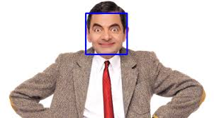
Thank You...

